Slide 1


21 DAYS OF
MACHINE LEARNING
12/21
---Code Warriors---

Slide 2

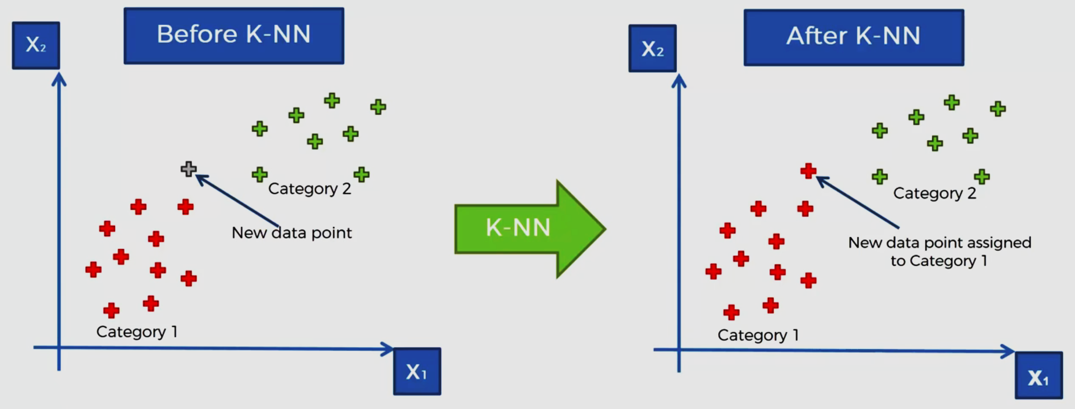
K-NN Algorithm
K-Nearest Neighbors is one of the most basic yet essential classification algorithms in Machine Learning. It belongs to the supervised learning domain and finds intense application in pattern recognition, data mining and intrusion detection.
---Code Warriors---

Slide 3
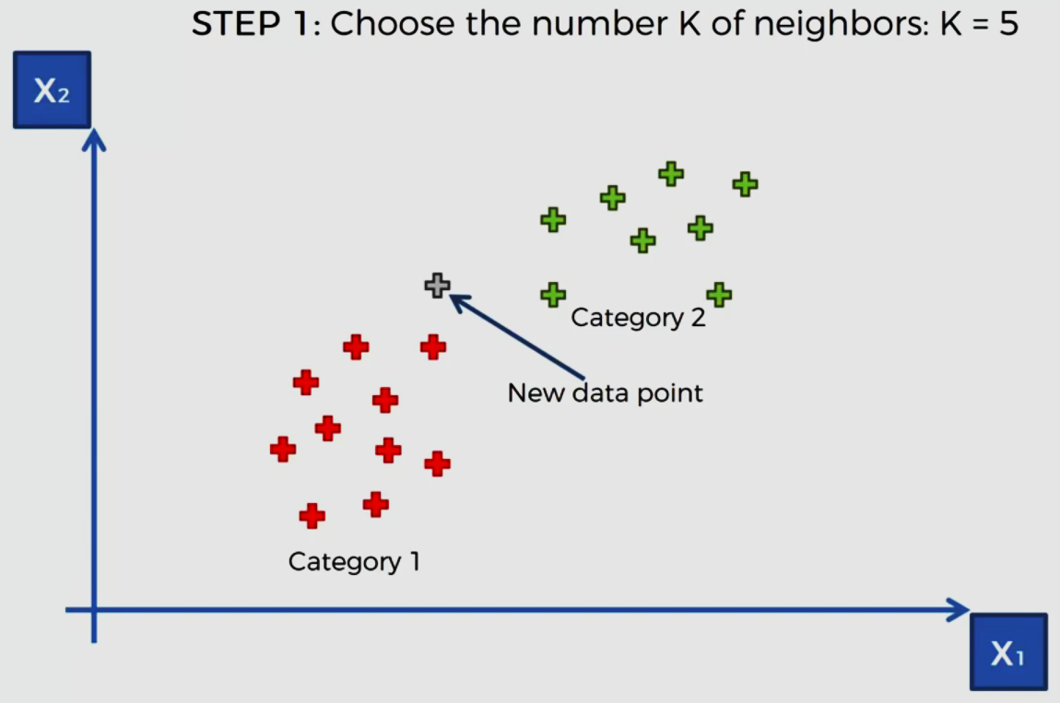
Step by step Explanation of K-NN Algo
---Code Warriors---

Slide 4
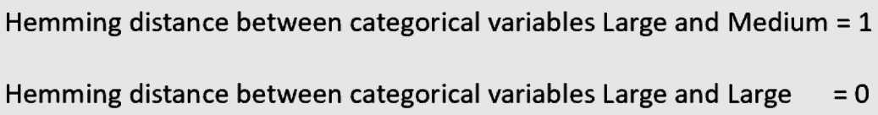
Types of Distances
Euclidean distance
Manhattan distance
Hamming Distance
Minkowski Distance
---Code Warriors---

Slide 5
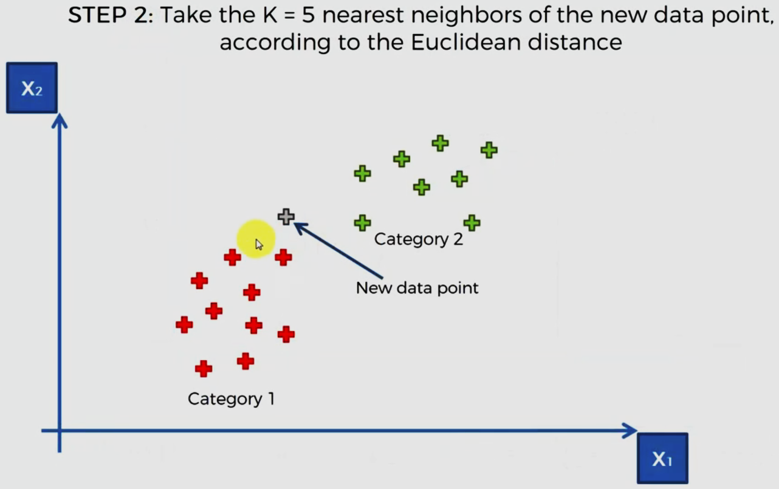
Step by step Explanation of K-NN Algo
---Code Warriors---

Slide 6
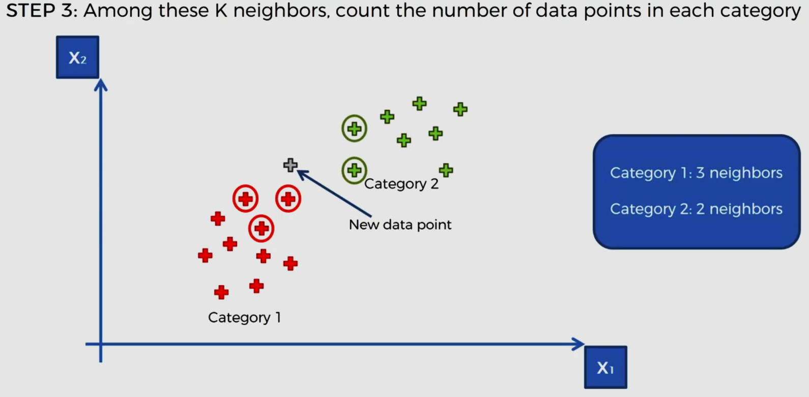
Step by step Explanation of K-NN Algo
---Code Warriors---

Slide 7
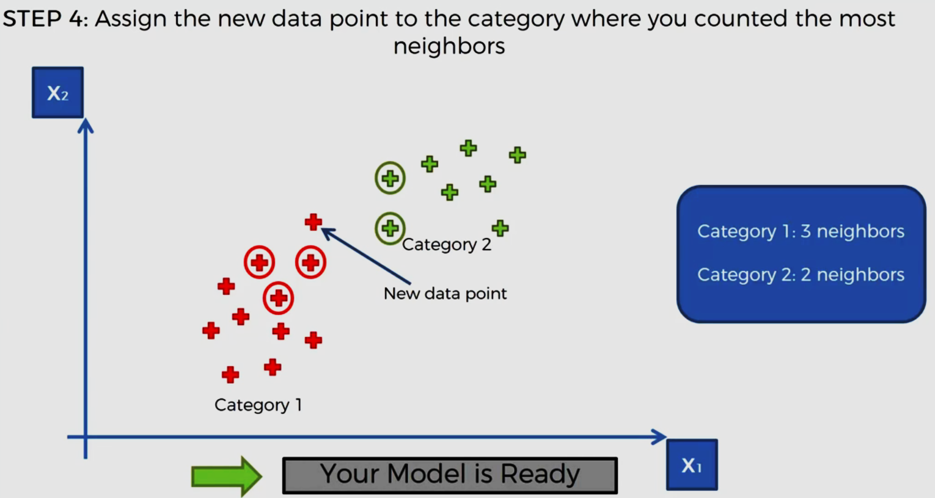
Step by step Explanation of K-NN Algo
---Code Warriors---

Slide 8
K-NN Algorithm
1
from sklearn.neighbors import KNeighborsClassifier
2
classifier = KNeighborsClassifier(n_neighbors = 5, metric = 'minkowski', p = 2)
3
classifier.fit(X_train, y_train)
4
y_pred = classifier.predict(X_test)
---Code Warriors---

Slide 9
K-NN Algorithm
Advantages
Dis-Advantages
Easy to use.
Quick calculation time.
Does not make assumptions about the data.
Distance of the new instance is computed with all the training samples every time.
Choosing the value of K is a tough choice to make as lower value of K results in higher influence of noise whereas increasing the number of K might result into overfitting.
KNN is computationally expensive as it searches the nearest neighbors for the new point at the prediction stage
---Code Warriors---

Slide 10





Applications of K-NN Algorithm
Stock Prediction
Text Mining
Medicine
Climate Forecasting
Movie and product recommendation system
---Code Warriors---

